Slide 1
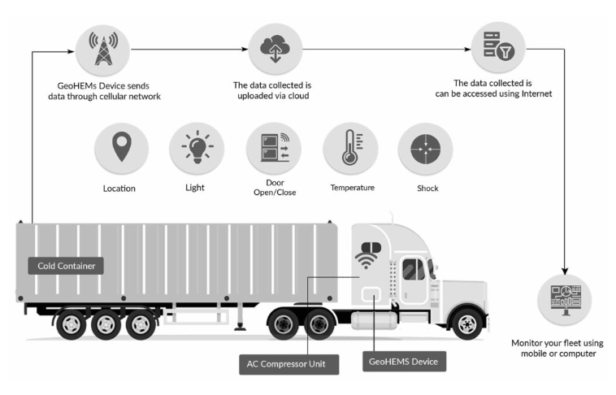
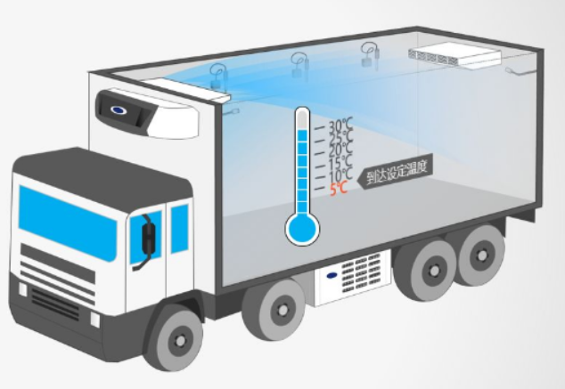
Over View
During the cold chain transportation, the temperature and humidity requirements are very high. Incorrect temperature can cause very serious financial lossWith the development of Internet of Things technology, many smart terminals have been applied to the cold chain transportation industry. The data of the current environment can be obtained in real time and uploaded to the cloud for analysis and monitoring

Slide 2
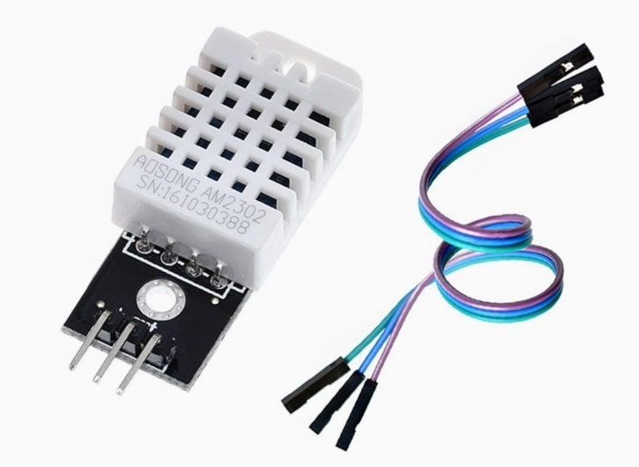
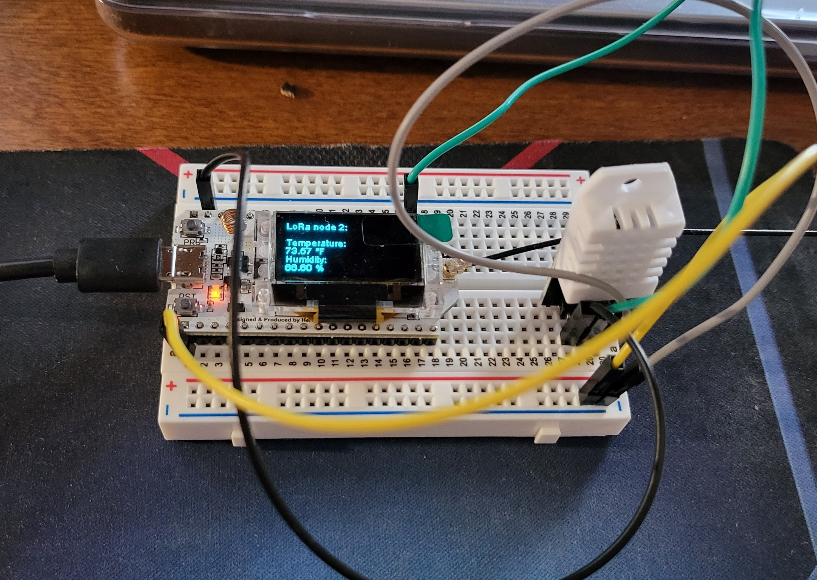
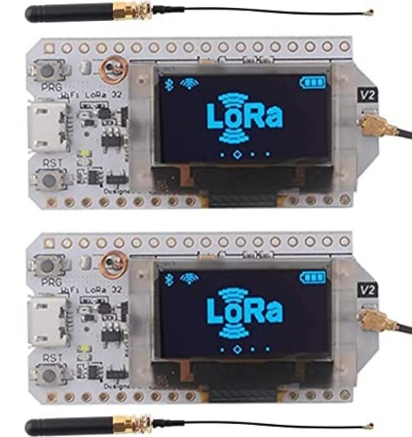
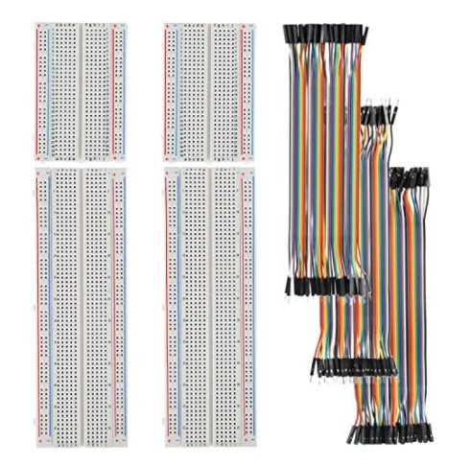
Hardware
The hardware part is mainly composed of DHT22 temperature and humidity sensor and ESP32 LoRa development board. DHT22 is responsible for collecting environmental data, ESP32 LoRa development board is responsible for data transmission, breadboard and DuPont line are responsible for connecting DHT22 and ESP32 LoRa development board

Slide 3
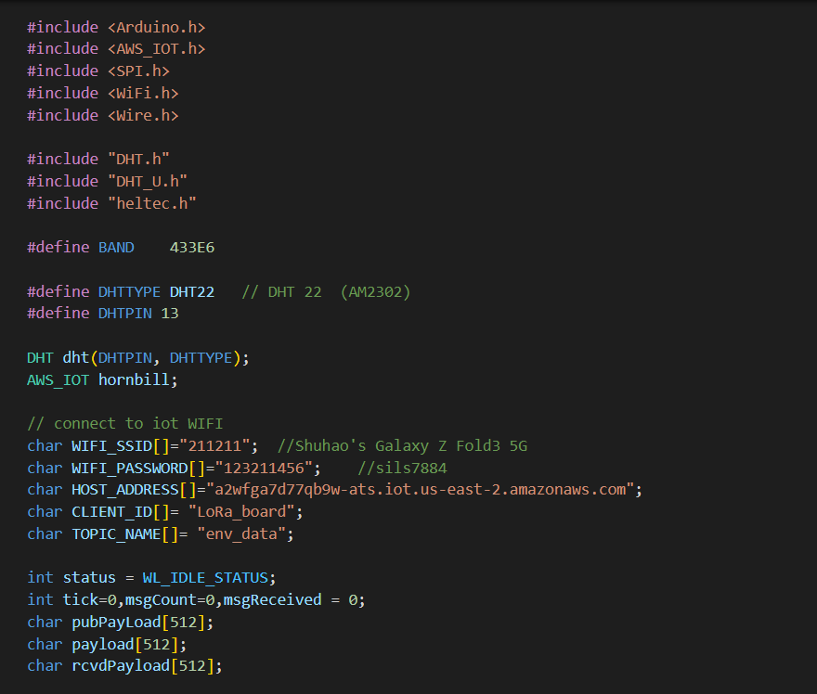
Configure Hardware
The code on the right shows how to configure the ESP32 LoRa to receive data from the DHT22 sensor and how to connect to WIFI.
“DHT.h” and “DHT_U.h” responsible for driving DHT22.
“AWS_IOT.h” responsible for obtaining links to AWS and “WiFi.h” responsible for connecting to the WiFi

Slide 4
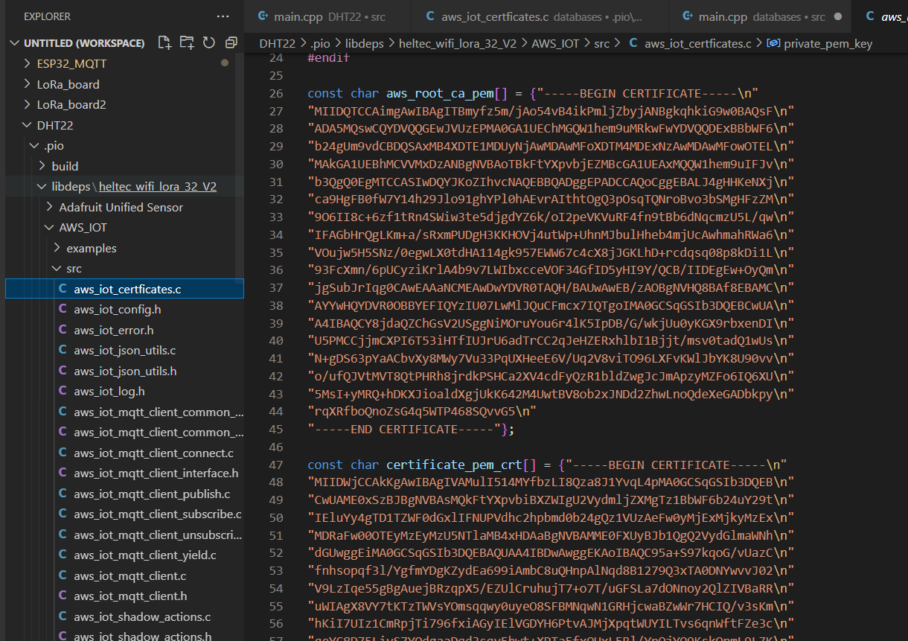
Configure Certificate for Hardware
In “aws_iot_certificates.c” file configure .crt certificate, CA certificate and device private key
This certificate is the credential for the device to access the AWS cloud

Slide 5
Network Architecture Description

Slide 6
LoRa & LoRaWAN
Difference | LoRa | LoRaWAN
Nature | LoRa is the modulation technique used in the physical layer of the LoRaWAN network, basically CSS (Chip Spread Spectrum) modulation, used to provide different data rates using different spreading factors | LoRaWAN is used as a wireless network for WAN due to its wide coverage capability
Application | Used as a robust modulation in LoRaWAN systems to help achieve different data rates | Used as a low power consumption, low data rate and long range wireless system. Popular in IoT/M2M based systems
Location | Have specific functions at the physical layer of the system | It has four layers: RF, physical layer, MAC layer and application layer

Slide 7
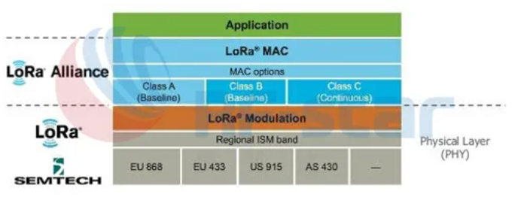
LoRa is a low-power, long-range, wireless, wide-area network standard created by semtech.
Working frequency: ISM frequency band includes 433, 868, 915 MH, etc.

Slide 8
MQTT Protocol
MQTT is a lightweight message transmission protocol based on the publish/subscribe model. It is specially designed for IoT applications in low-bandwidth and unstable network environments. It can provide real-time and reliable message services for networked devices with very little code. Simple and easy to implement
Support QoS (equipment network environment is complex)
Lightweight and bandwidth-saving
Data-independent (don't care about Payload data format)
Persistent session awareness (know whether the device is online at all times)

Slide 9
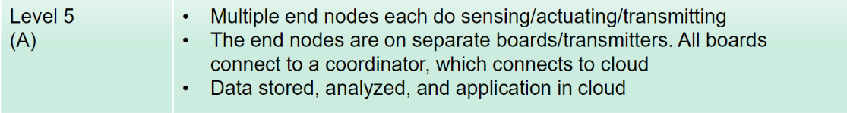

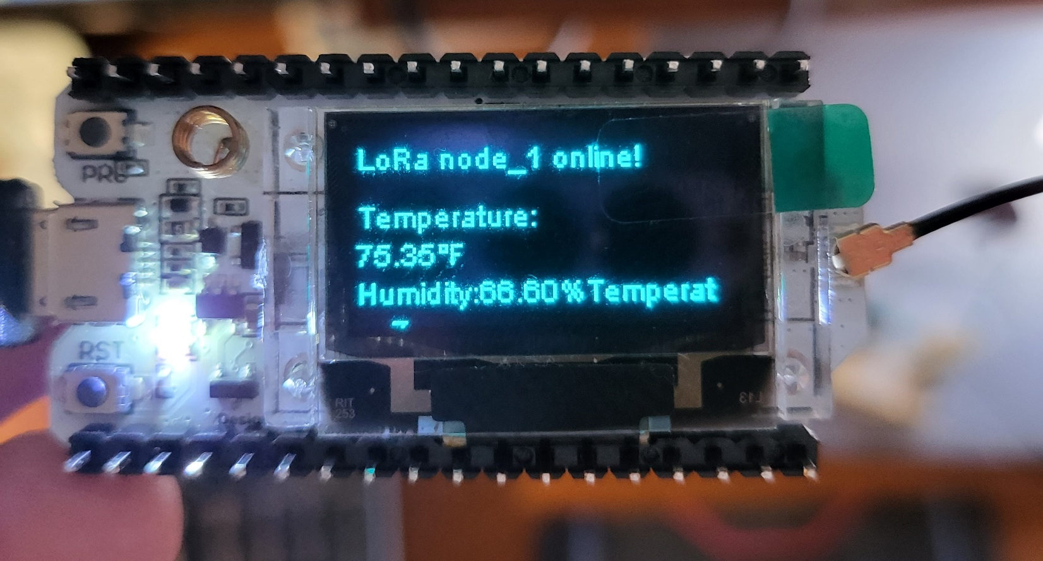
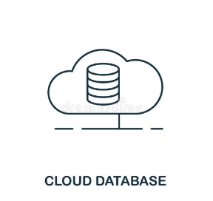
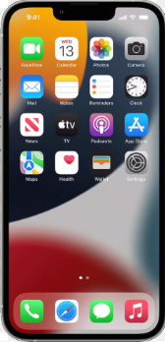
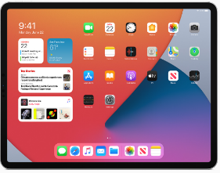
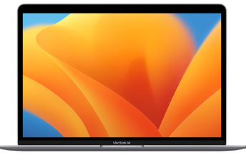
Implementation 1
Due to budget reasons, we cannot use the LoRa gateway for LoRaWAN networking, so we use a single board
to achieve LoRa point-to-point communication 【Point to Point Only】
LoRa
LoRaNode 1
LoRa
MQTT
LoRaNode 2
LoRa
LoRaNode 3

Slide 10

Implementation 2
Use the MQTT protocol to realize the three boards individually connected to the AWS cloud
MQTT
LoRaNode 1
MQTT
LoRaNode 2
MQTT
LoRaNode 3

Slide 11
Cloud Experiment Description

Slide 12
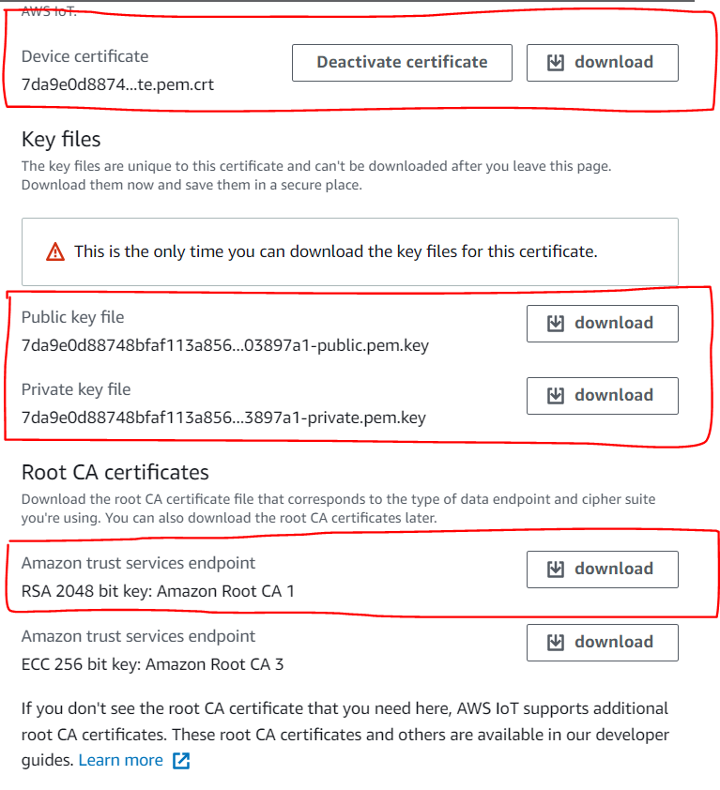
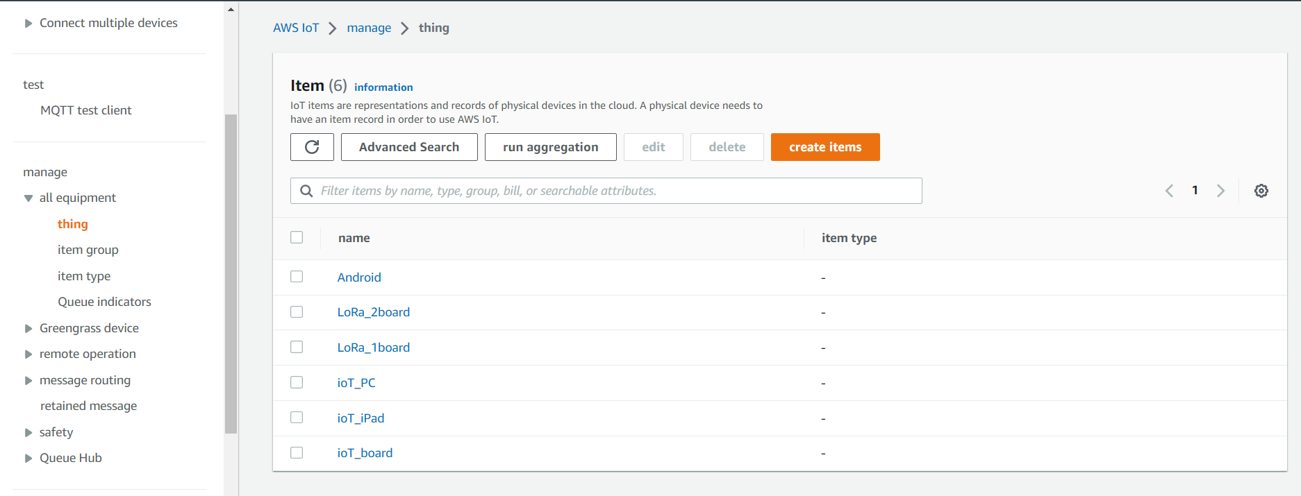
Connect To AWS
AWS will create a virtual item in the cloud corresponding to each device connected to the cloud. Therefore,
the first step in configuring AWS is to create virtual items in AWS for the devices that need to be connected,
and then generate authentication certificates for the created items. After downloading the authentication
certificates, set rules and access policies.

Slide 13
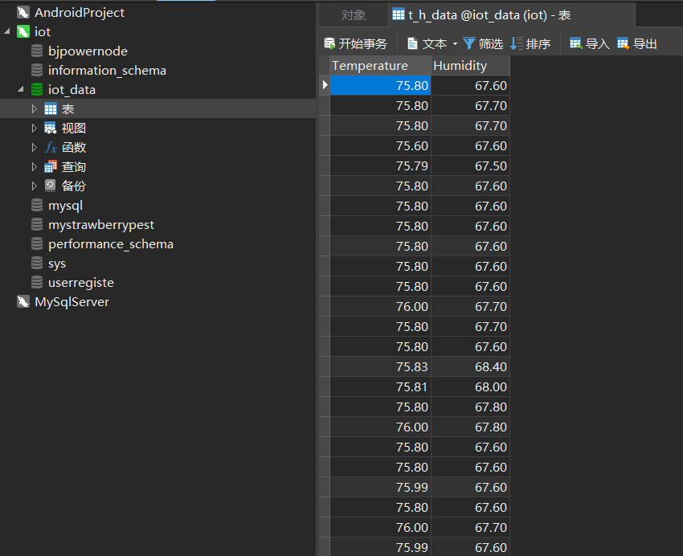
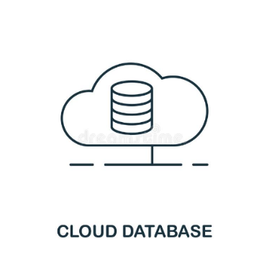
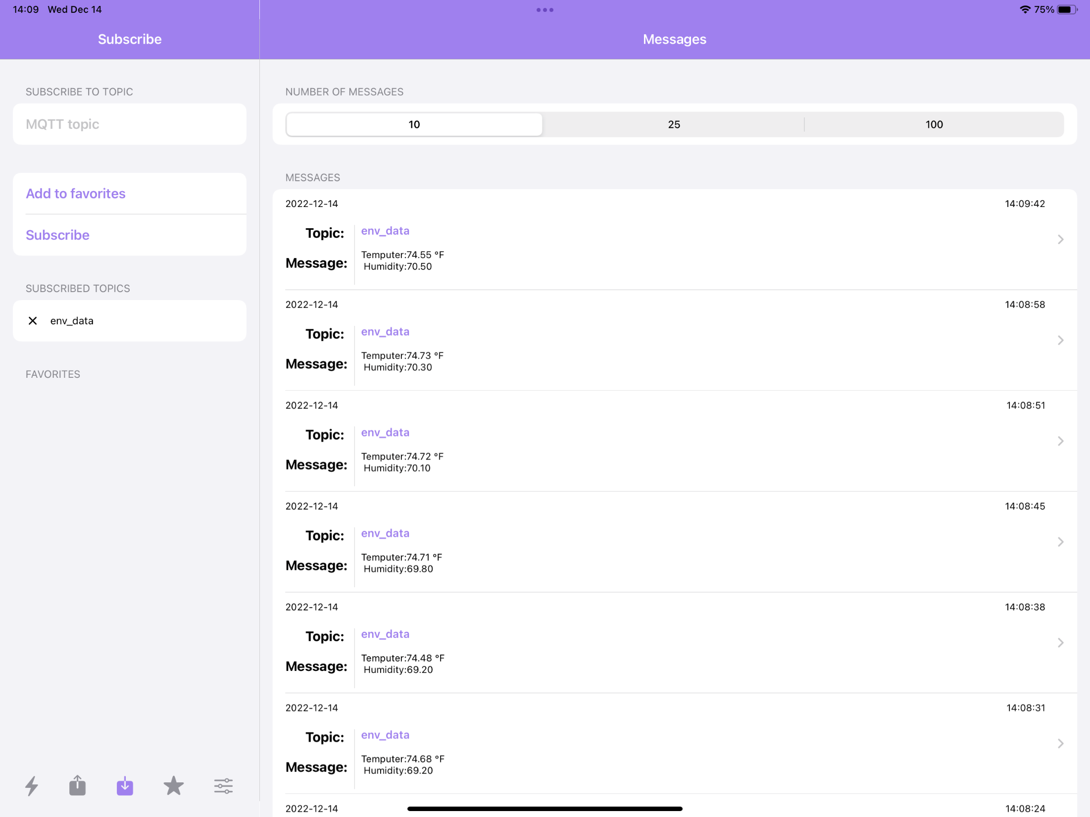
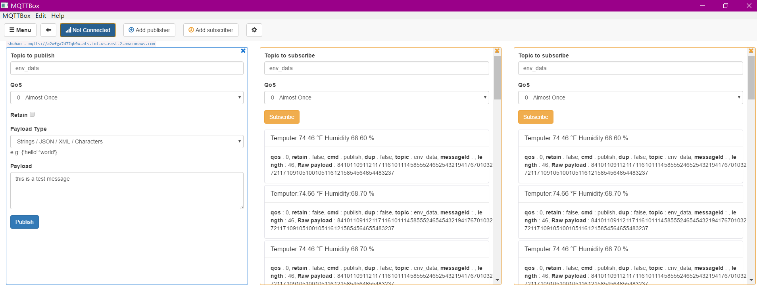
Data Store & Analyze & Exhibit
Store
Analyze
Web Diagram
Exhibit
Exhibit
MySQL
PC & Laptop
Ipad

Slide 14
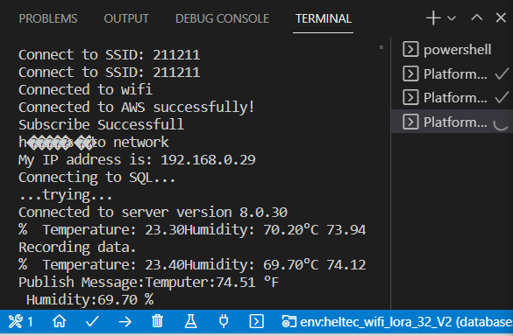
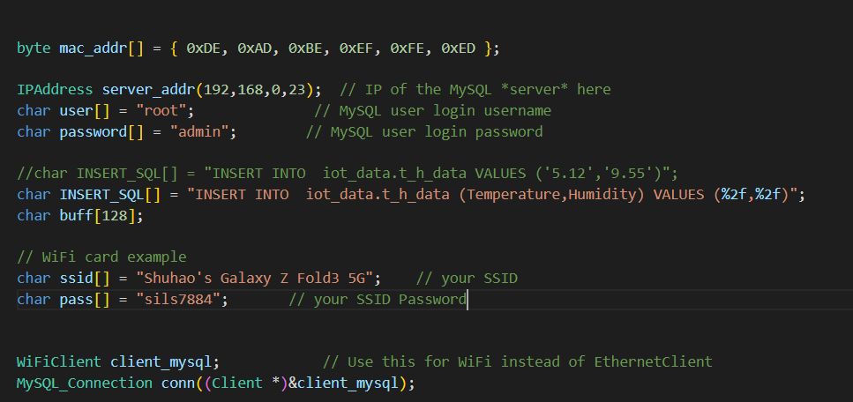
How Data Store to Cloud database
The code on the right shows how to store ESP32 data into the database.
The figure on the left shows the information printed from the console. The console prints information successfully connected to the AWS cloud, and successfully connected to the MySQL cloud database, the version number is 8.0.30

Slide 15

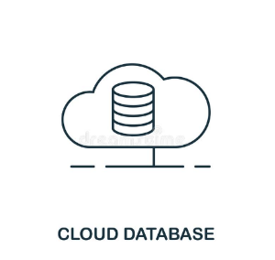
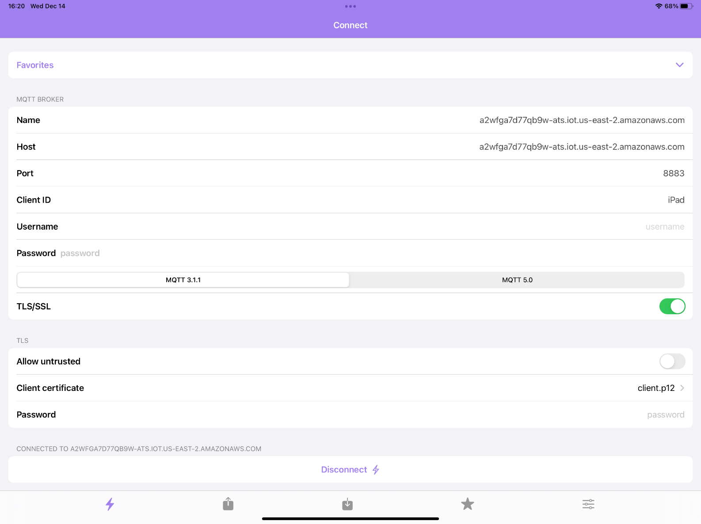
How Data Be Exhibited
Configure Ipad (Mobile)
It is necessary to configure the CA root certificate, private key device certificate of the AWS site.
For Apple devices, the certificate in .cert format needs to be converted into a certificate in .p12 format

Slide 16
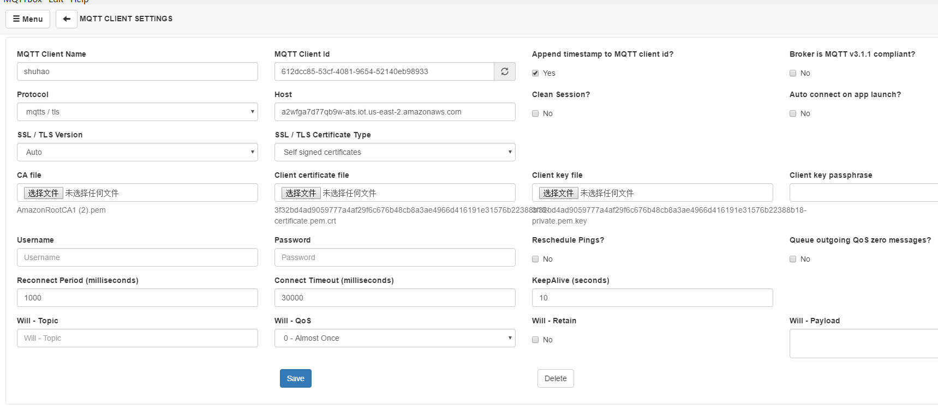
How Data Be Exhibited
Configure PC & Laptop
It is necessary to configure the CA root certificate, private key device certificate of the AWS site.

Slide 17
How Data Be Analyzed
Web Diagram

